Slide 1
Machine Learning
Chapter 18.1-18.3
Some material adopted from notes by Chuck Dyer
‹#›
Notes:
‹#›

Slide 2
Today’s Class
Machine learning
What is ML?
Inductive learning
Supervised
Unsupervised
Decision trees
Later we’ll cover Bayesian learning, naïve Bayes, and BN learning
‹#›
Notes:
‹#›

Slide 3
Why Learn?
Understand and improve efficiency of human learning
Use to improve methods for teaching and tutoring people (e.g., better computer-aided instruction)
Discover new things or structure that were previously unknown to humans
Examples: data mining, scientific discovery
Fill in skeletal or incomplete specifications about a domain
Large, complex AI systems cannot be completely derived by hand and require dynamic updating to incorporate new information.
Learning new characteristics expands the domain or expertise and lessens the “brittleness” of the system
Build software agents that can adapt to their users or to other software agents
‹#›
Notes:
‹#›

Slide 4
Major Paradigms of Machine Learning
Rote learning – One-to-one mapping from inputs to stored representation. “Learning by memorization.” Association-based storage and retrieval.
Induction – Use specific examples to reach general conclusions
Clustering – Unsupervised identification of natural groups in data
Analogy – Determine correspondence between two different representations
Discovery – Unsupervised, specific goal not given
Genetic algorithms – “Evolutionary” search techniques, based on an analogy to “survival of the fittest”
Reinforcement – Feedback (positive or negative reward) given at the end of a sequence of steps
‹#›
Notes:
‹#›

Slide 5
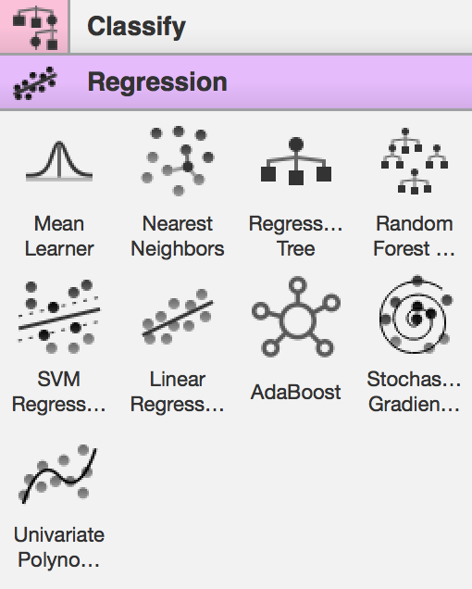
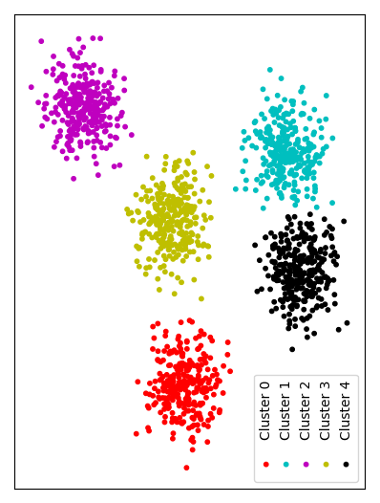
‹#›

Slide 6
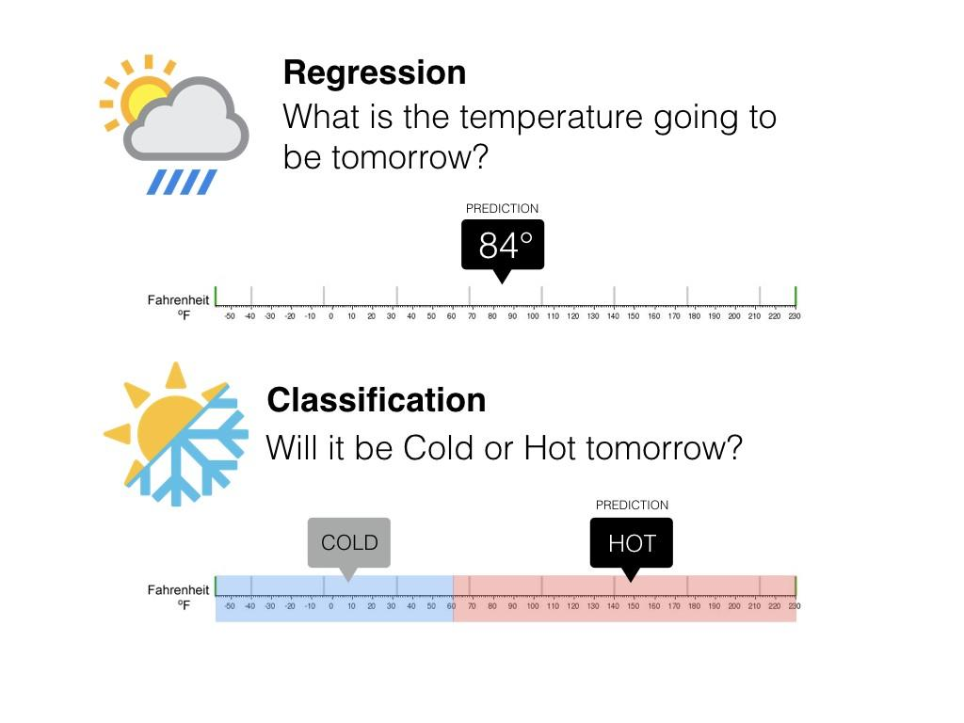
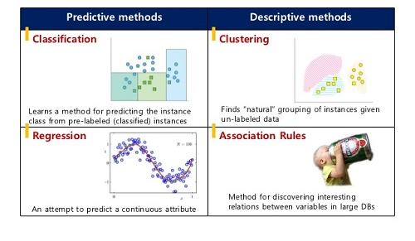
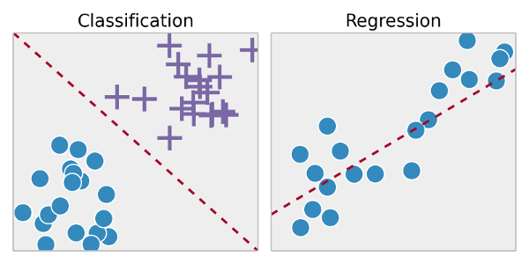
‹#›

Slide 7
Classification Learning: Definition
Given a collection of records (training set)
Each record contains a set of attributes, one of the attributes is the class
Find a model for the class attribute as a function of the values of the other attributes
Goal: previously unseen records should be assigned a class as accurately as possible
Use test set to estimate the accuracy of the model
Often, the given data set is divided into training and test sets, with training set used to build the model and test set used to validate it

Slide 8
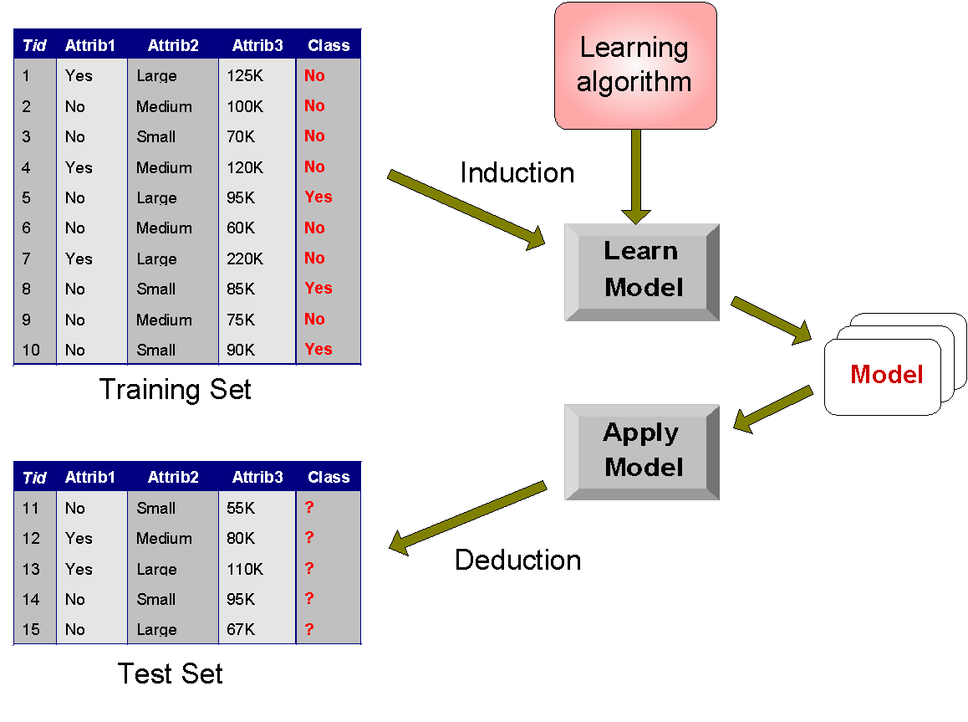
Illustrating Classification Learning

Slide 9

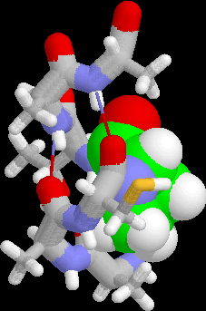


Examples of Classification Task
Predicting tumor cells as benign or malignant
Classifying credit card transactions as legitimate or fraudulent
Classifying secondary structures of protein as alpha-helix, beta-sheet, or random coil
Categorizing news stories as finance, weather, entertainment, sports, etc.

Slide 10
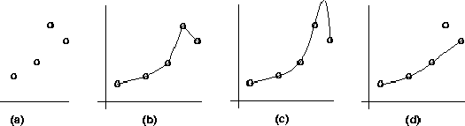
Inductive Learning and Bias
Suppose that we want to learn a function f(x) = y and we are given some sample (x,y) pairs, as in figure (a)
There are several hypotheses we could make about this function, e.g.: (b), (c) and (d)
A preference for one over the others reveals the bias of our learning technique, e.g.:
prefer piece-wise functions (b)
prefer a smooth function (c)
prefer a simple function and treat outliers as noise (d)
Notes:
‹#›

Slide 11
Inductive Learning as Search
Instance space I defines the language for the training and test instances
Typically, but not always, each instance i ∈ I is a feature vector
Features are also sometimes called attributes or variables
I: V₁ x V₂ x … x V_{k}, i = (v₁, v₂, …, v_{k})
Class variable C gives an instance’s class (to be predicted)
Model space M defines the possible classifiers
M: I → C, M = {m₁, … m_{n}} (possibly infinite)
Model space is sometimes, but not always, defined in terms of the same features as the instance space
Training data can be used to direct the search for a good (consistent, complete, simple) hypothesis in the model space
‹#›
Notes:
‹#›

Slide 12
Model Spaces
Decision trees
Partition the instance space into axis-parallel regions, labeled with class value
Nearest-neighbor classifiers
Partition the instance space into regions defined by the centroid instances (or cluster of k instances)
Bayesian networks (probabilistic dependencies of class on attributes)
Naïve Bayes: special case of BNs where class → each attribute
Neural networks
Nonlinear feed-forward functions of attribute values
Support vector machines
Find a separating plane in a high-dimensional feature space
Associative rules (feature values → class)
First-order logical rules
‹#›
Notes:
‹#›

Slide 13
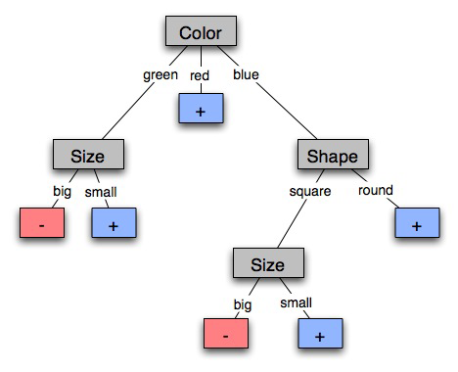
Learning Decision Trees
Goal: Build a decision tree to classify examples as positive or negative instances of a concept using supervised learning from a training set
A decision tree is a tree where
each non-leaf node has associated with it an attribute (feature)
each leaf node has associated with it a classification (+ or -)
each arc has associated with it one of the possible values of the attribute at the node from which the arc is directed
Generalization: allow for >2 classes
e.g., {sell, hold, buy}
‹#›
Notes:
‹#›

Slide 14
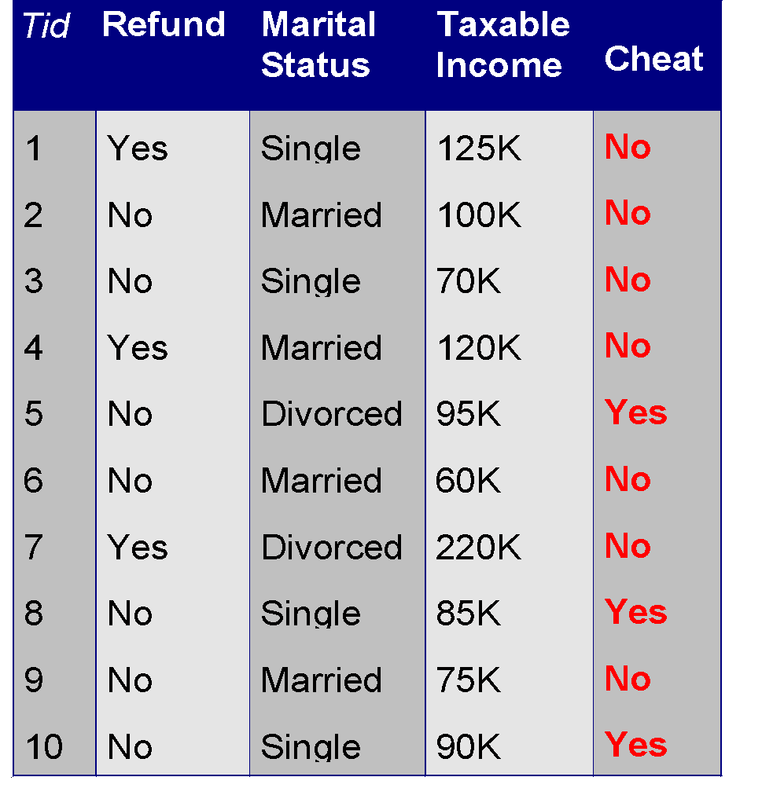
Example of a Decision Tree
Refund
Yes
No
NO
MarSt
Single, Divorced
Married
TaxInc
NO
< 80K
> 80K
NO
YES
Training Data
Model: Decision Tree

Slide 15
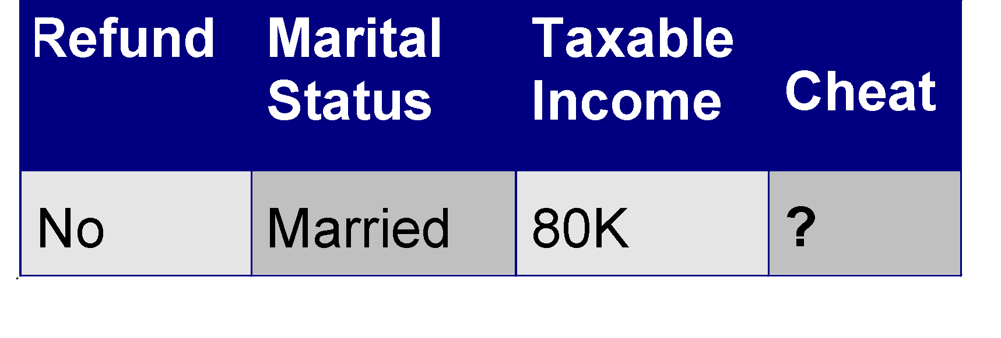
Apply Model to Test Data
Test Data
Start at the root of tree
Refund
Yes
No
NO
MarSt
Single, Divorced
Married
TaxInc
NO
< 80K
> 80K
NO
YES

Slide 16
Apply Model to Test Data
Test Data
Refund
Yes
No
NO
MarSt
Single, Divorced
Married
TaxInc
NO
< 80K
> 80K
NO
YES

Slide 17
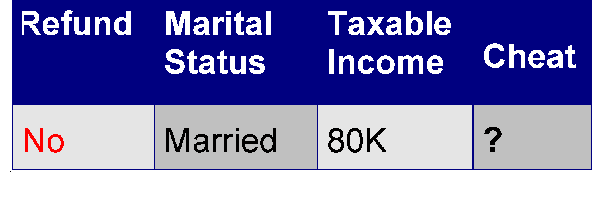
Apply Model to Test Data
Test Data
Refund
Yes
No
NO
MarSt
Single, Divorced
Married
TaxInc
NO
< 80K
> 80K
NO
YES

Slide 18
Apply Model to Test Data
Test Data
Refund
Yes
No
NO
MarSt
Single, Divorced
Married
TaxInc
NO
< 80K
> 80K
NO
YES

Slide 19
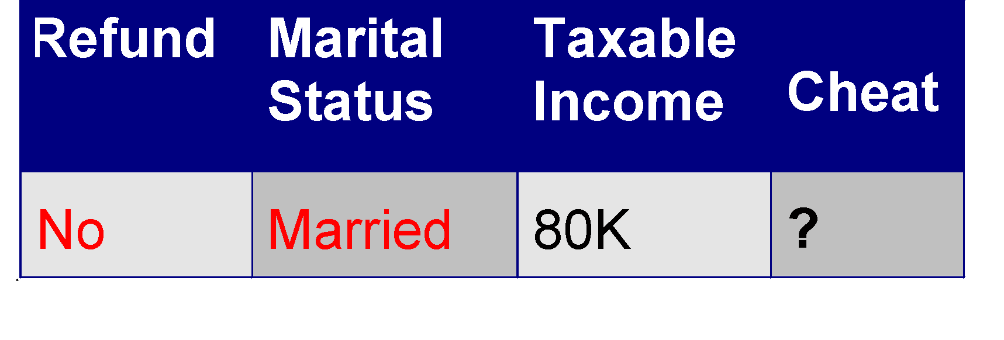
Apply Model to Test Data
Test Data
Refund
Yes
No
NO
MarSt
Single, Divorced
Married
TaxInc
NO
< 80K
> 80K
NO
YES

Slide 20
Apply Model to Test Data
Test Data
Refund
Yes
No
NO
MarSt
Single, Divorced
Married
Assign Cheat to “No”
TaxInc
NO
< 80K
> 80K
NO
YES

Slide 21
Information Theory
Information is measured in bits
Information conveyed by a message depends on its probability
With n equally probable possible messages, the probability p of each is 1/n
Information conveyed by message is log₂(n) = -log₂(p)
e.g., with 16 messages, then log₂ (16) = 4 and we need 4 bits to identify/send each message
Given probability distribution for n messages P = (p₁,p₂…p_{n}), the information conveyed by distribution (aka entropy of P) is:
I(P) = -(p₁*log₂ (p₁) + p₂*log₂ (p₂) + .. + p_{n}*log₂ (p_{n}))
probability of msg 2
info in msg 2
Notes:
‹#›

Slide 22
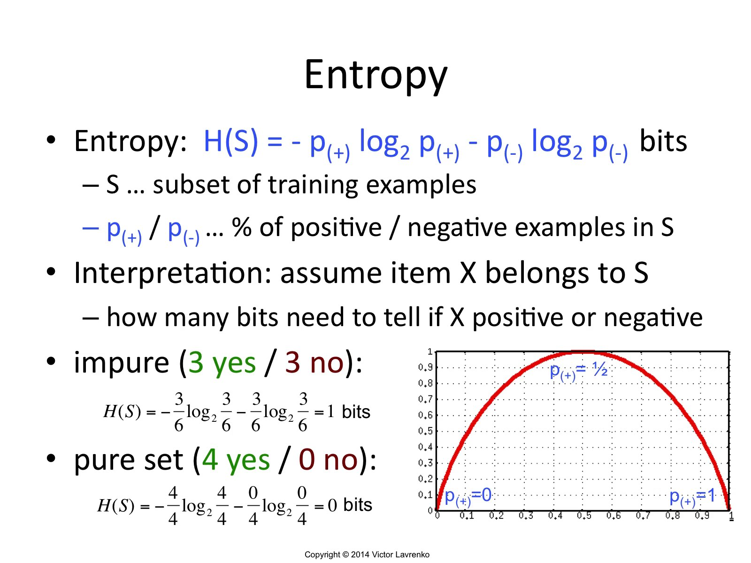
‹#›

Slide 23
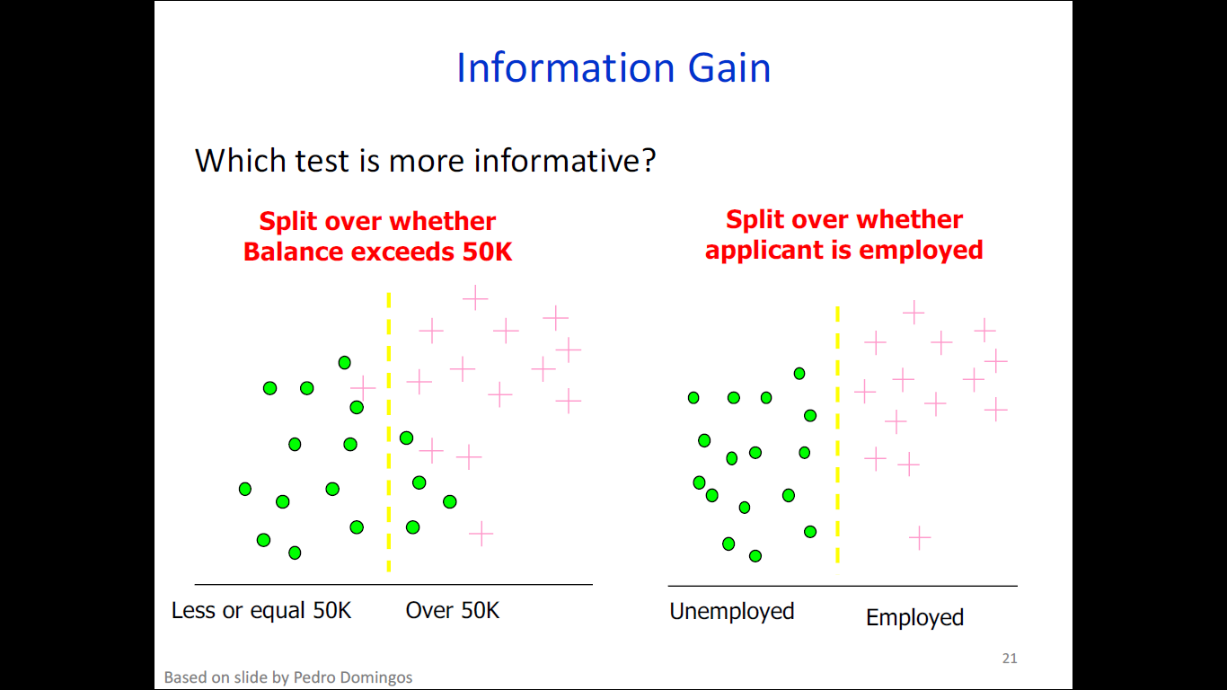
‹#›

Slide 24
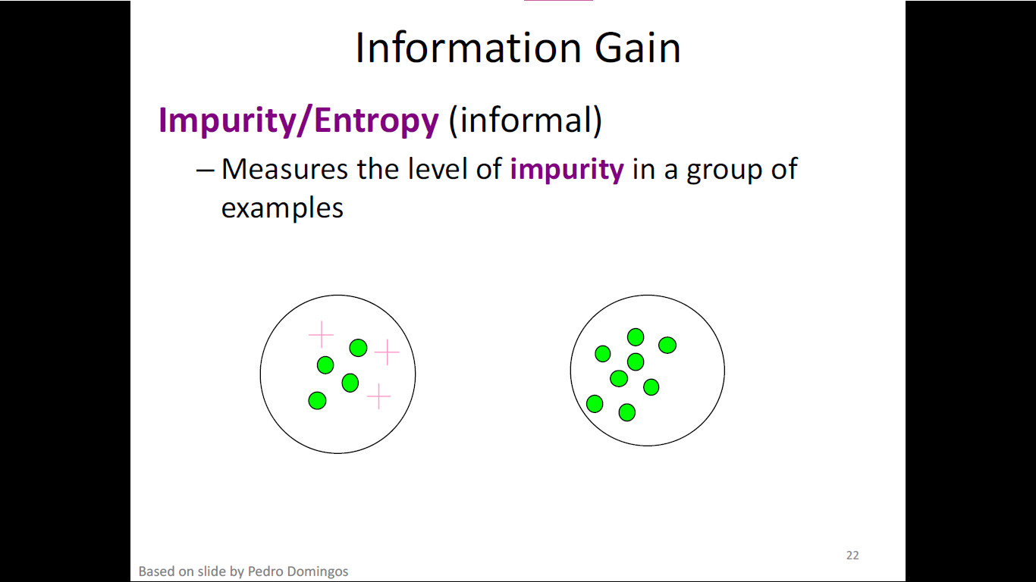
‹#›

Slide 25
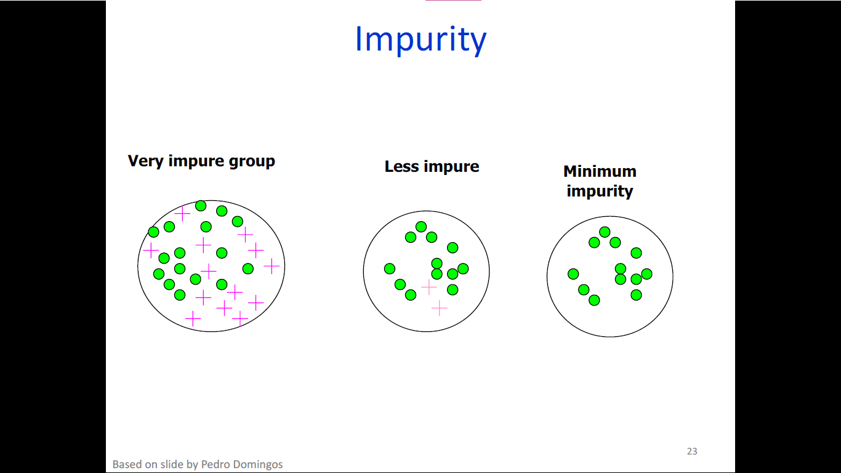
‹#›

Slide 26
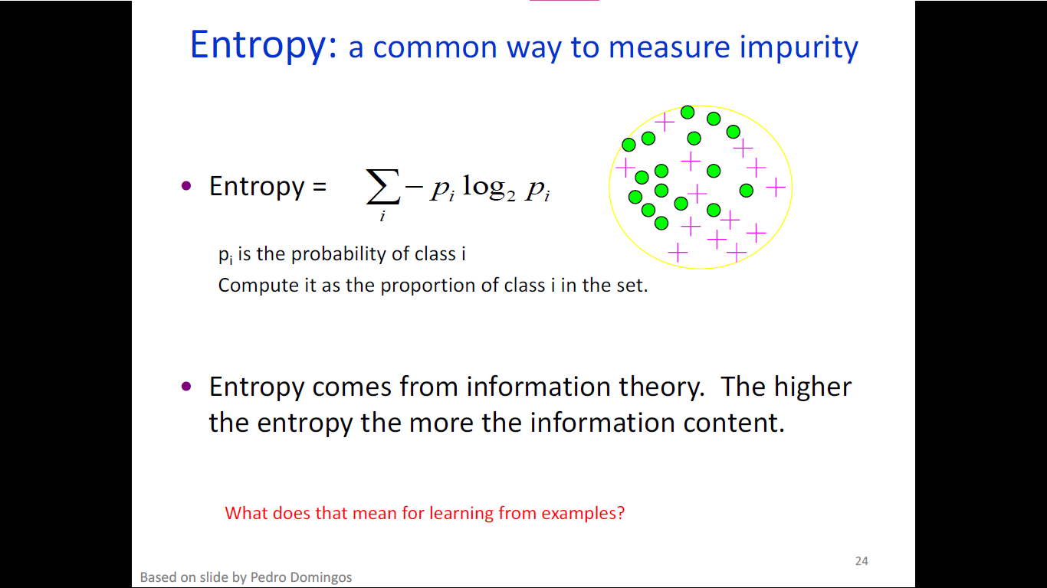
‹#›

Slide 27
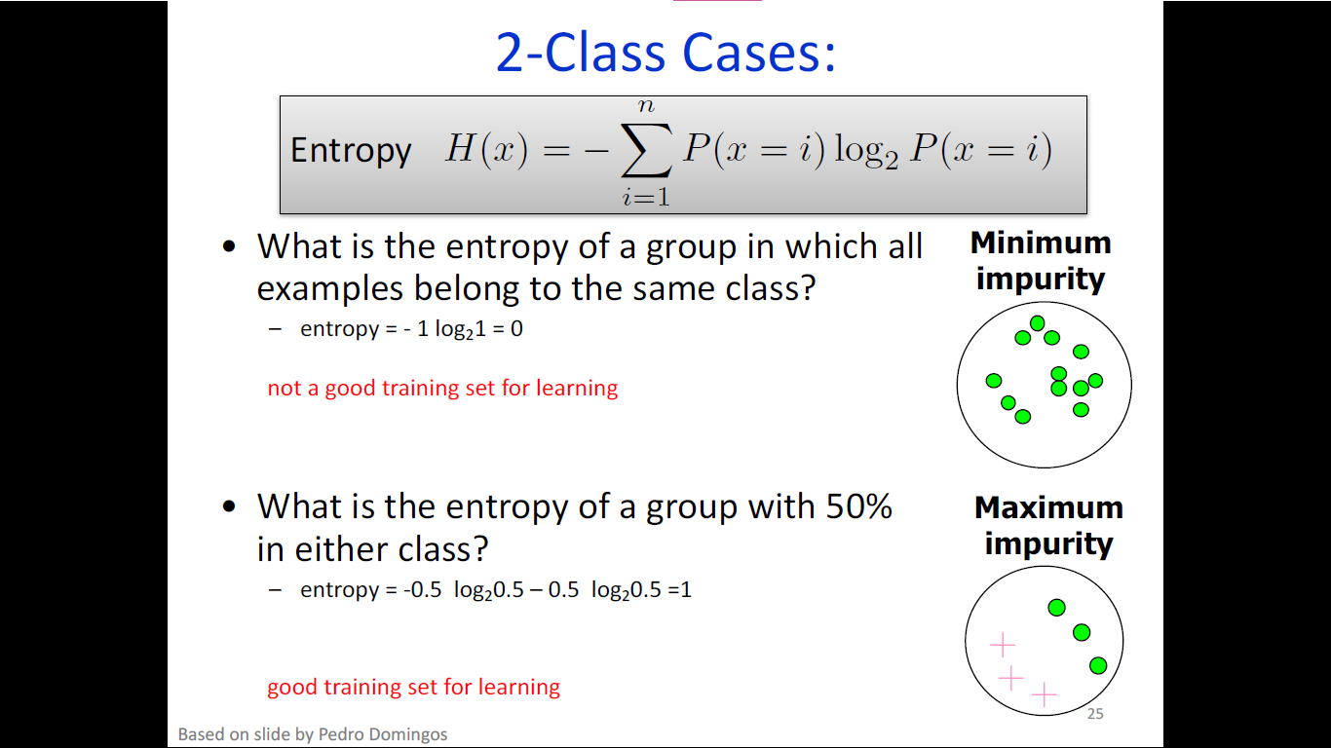
‹#›

Slide 28
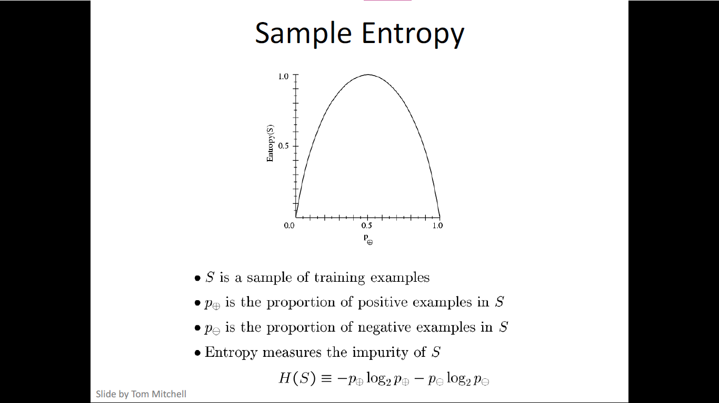
‹#›

Slide 29
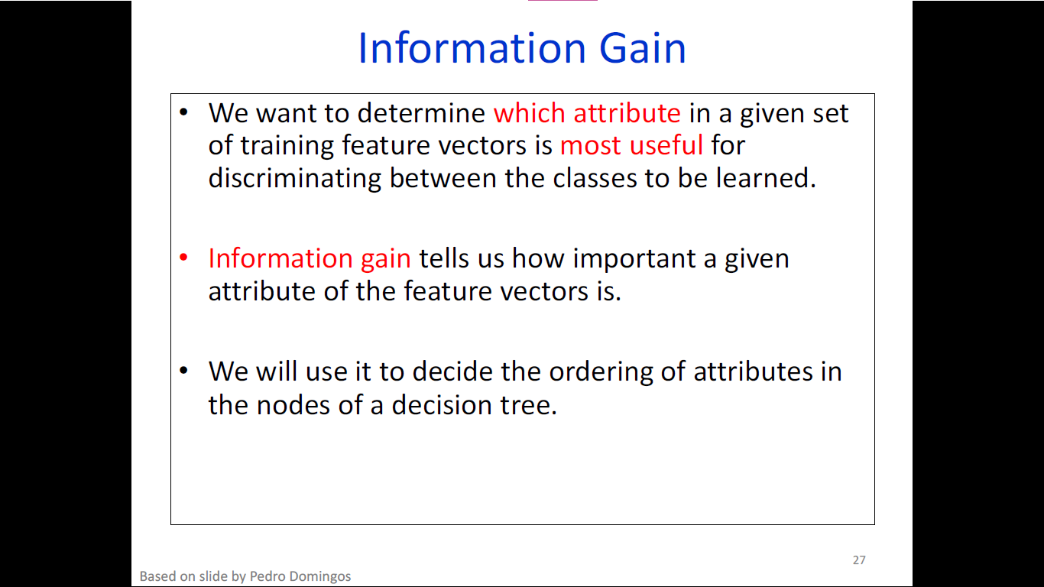
‹#›

Slide 30
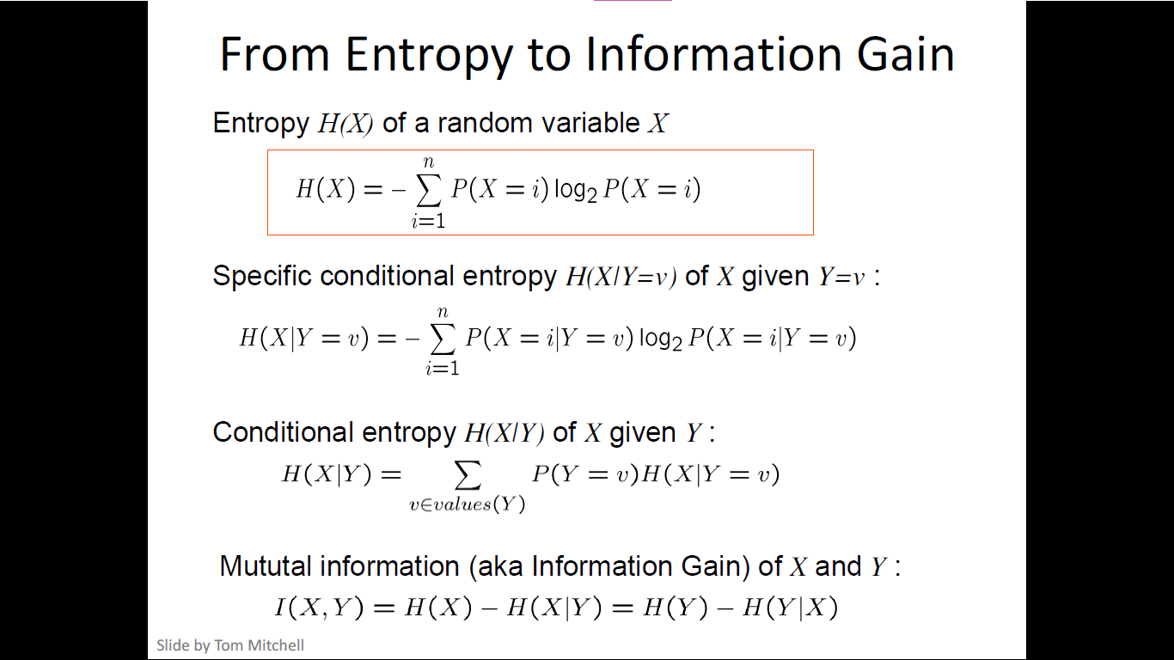
‹#›

Slide 31
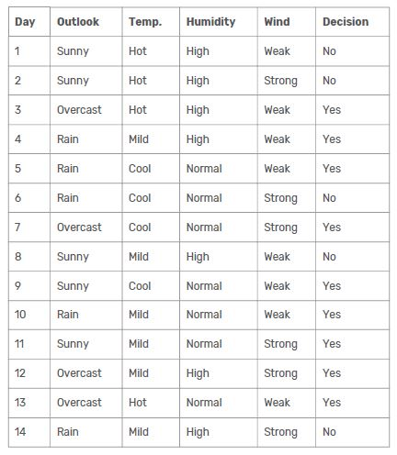
Decision Tree
Notes:
‹#›

Slide 32

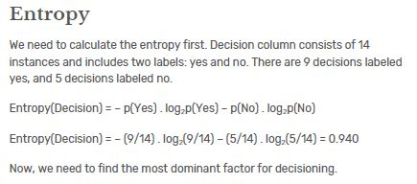
Decision Tree
We can summarize the ID3 algorithm as illustrated below
Notes:
‹#›

Slide 33
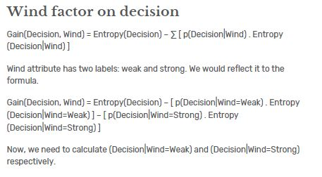
Decision Tree
Notes:
‹#›

Slide 34
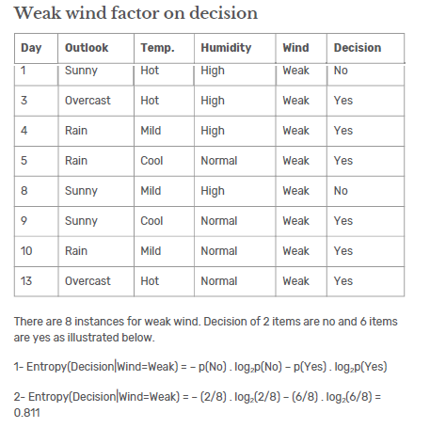
Decision Tree
Notes:
‹#›

Slide 35
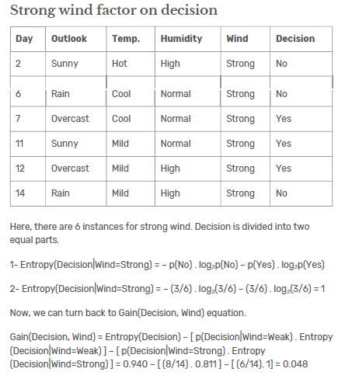
Decision Tree
Notes:
‹#›

Slide 36
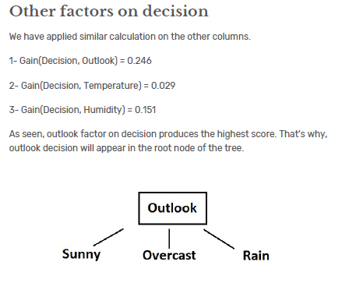
Decision Tree
Notes:
‹#›

Slide 37
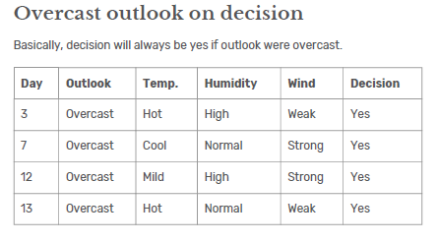
Decision Tree
Notes:
‹#›

Slide 38
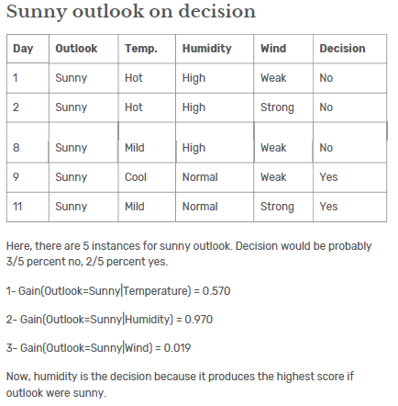
Decision Tree
Notes:
‹#›

Slide 39
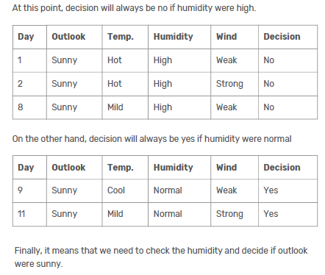
Decision Tree
Notes:
‹#›

Slide 40
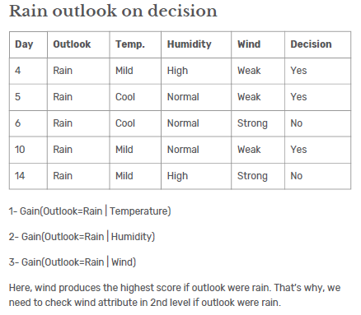
Decision Tree
Notes:
‹#›

Slide 41
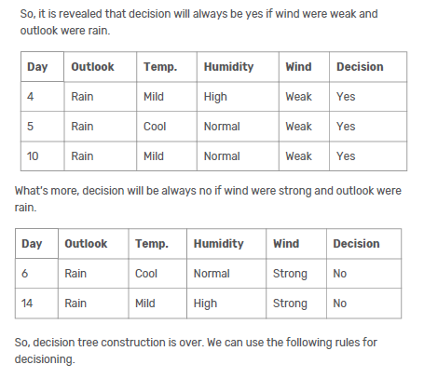
Decision Tree
Notes:
‹#›

Slide 42
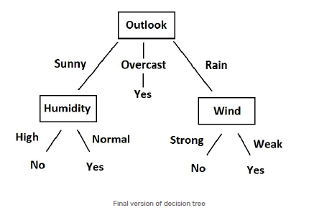
Decision Tree
Notes:
‹#›

Slide 43
Extensions of the Decision Tree Learning Algorithm
Using gain ratios
Real-valued data
Noisy data and overfitting
Generation of rules
Setting parameters
Cross-validation for experimental validation of performance
C4.5 is an extension of ID3 that accounts for unavailable values, continuous attribute value ranges, pruning of decision trees, rule derivation, and so on
‹#›
Notes:
‹#›

Slide 44
Using Gain Ratios
The information gain criterion favors attributes that have a large number of values
If we have an attribute D that has a distinct value for each record, then Info(D,T) is 0, thus Gain(D,T) is maximal
To compensate for this Quinlan suggests using the following ratio instead of Gain:
GainRatio(D,T) = Gain(D,T) / SplitInfo(D,T)
SplitInfo(D,T) is the information due to the split of T on the basis of value of categorical attribute D
SplitInfo(D,T) = I(|T1|/|T|, |T2|/|T|, .., |Tm|/|T|)
where {T1, T2, .. Tm} is the partition of T induced by value of D
‹#›
Notes:
‹#›

Slide 45
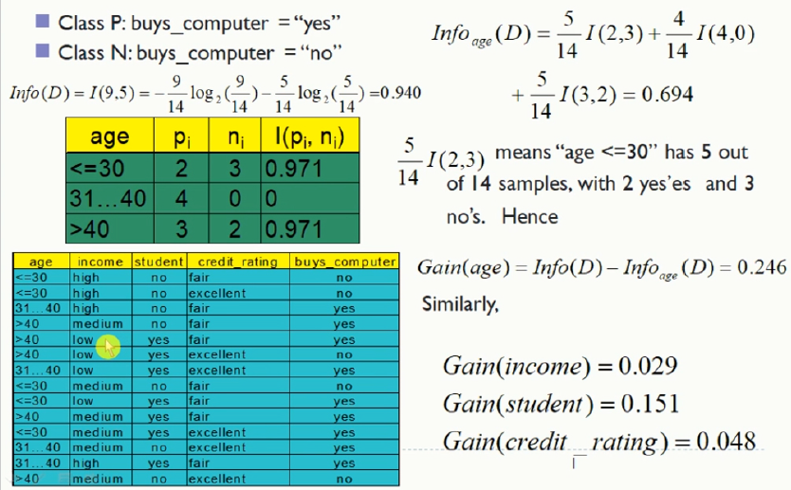
Computing Gain Ratio
‹#›
Notes:
‹#›

Slide 46
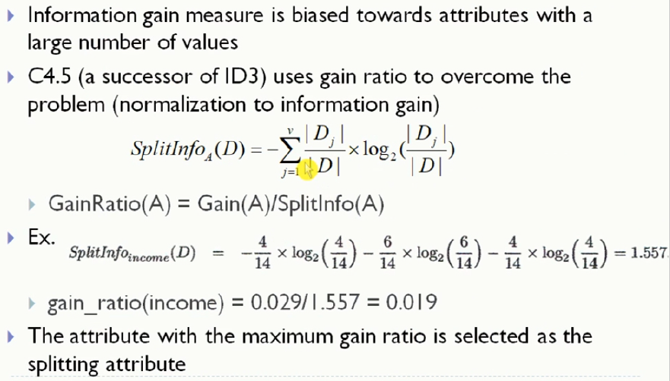
Computing Gain Ratio
‹#›
Notes:
‹#›

Slide 47
Choosing the Best Attribute
The key problem is choosing which attribute to split a given set of examples
Some possibilities are:
Random: Select any attribute at random
Least-Values: Choose the attribute with the smallest number of possible values
Most-Values: Choose the attribute with the largest number of possible values
Max-Gain: Choose the attribute that has the largest expected information gain–i.e., the attribute that will result in the smallest expected size of the subtrees rooted at its children
The ID3 algorithm uses the Max-Gain method of selecting the best attribute
‹#›
Notes:
‹#›

Slide 48
Measuring Model Quality
How good is a model?
Predictive accuracy
False positives / false negatives for a given cutoff threshold
Loss function (accounts for cost of different types of errors)
Area under the (ROC) curve
Minimizing loss can lead to problems with overfitting
Training error
Train on all data; measure error on all data
Subject to overfitting (of course we’ll make good predictions on the data on which we trained!)
Regularization
Attempt to avoid overfitting
Explicitly minimize the complexity of the function while minimizing loss. Tradeoff is modeled with a regularization parameter
‹#›

Slide 49
Cross-Validation
Holdout cross-validation:
Divide data into training set and test set
Train on training set; measure error on test set
Better than training error, since we are measuring generalization to new data
To get a good estimate, we need a reasonably large test set
But this gives less data to train on, reducing our model quality!
‹#›

Slide 50
Cross-Validation, cont.
k-fold cross-validation:
Divide data into k folds
Train on k-1 folds, use the kth fold to measure error
Repeat k times; use average error to measure generalization accuracy
Statistically valid and gives good accuracy estimates
Leave-one-out cross-validation (LOOCV)
k-fold cross validation where k=N (test data = 1 instance!)
Quite accurate, but also quite expensive, since it requires building N models
‹#›

Slide 51
Summary: Decision Tree Learning
Inducing decision trees is one of the most widely used learning methods in practice
Can out-perform human experts in many problems
Strengths include
Fast
Simple to implement
Can convert result to a set of easily interpretable rules
Empirically valid in many commercial products
Handles noisy data
Weaknesses include:
Univariate splits/partitioning using only one attribute at a time so limits types of possible trees
Large decision trees may be hard to understand
Requires fixed-length feature vectors
Non-incremental (i.e., batch method)
‹#›
Notes:
‹#›

